Slide 1
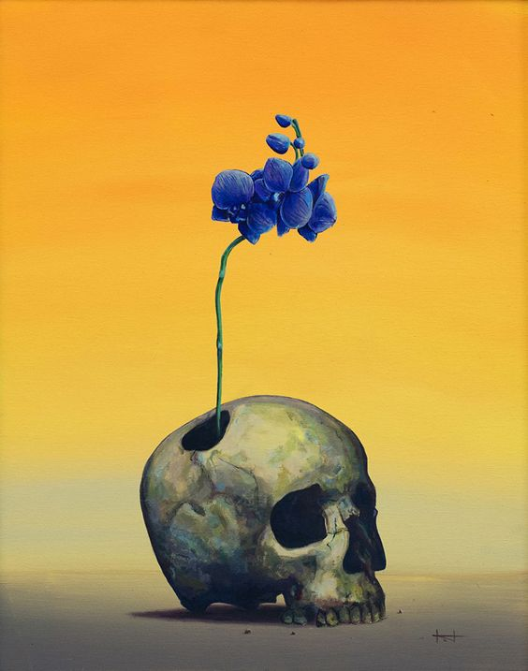
VISUAL ART
FIA2 – DEVELOPING YOUR INQUIRY
In FIA2, you explored how artists use different lenses to interpret people, places and objects. Through a series of experiments, you investigated how visual language can communicate your personal viewpoint about connection.
In FIA2, you will continue developing ONE direction from your FIA2 investigation. You will refine your ideas, test alternatives, and begin resolving your work with greater clarity and intention.
WHAT IS FIA2?
FIA1 = exploration FIA2 = development
You are not starting again. You are continuing what you have already begun.
Research. Experiment. Explore. Create

Slide 2
YOUR DIRECTION
What focus are you continuing from FIA1?
• Place / Object / People / Time • Which lens are you exploring?
REFINED INQUIRY
Write your inquiry question:
(You may refine your FIA1 question if needed)
PROPOSAL (100–150 words)
Explain:
• What you will create? What ideas you are exploring? How your work connects to your FIA1 experiment? What you want your audience to understand

Slide 3
PROPOSAL – FIA2
ARTIST CONNECTION
• What do they explore?
• How do they use visual language?
• What will you apply in your work?
Example of works IMAGES OF ARTISTS WORK
Artist name
Mentor
Artists
Artist name
ARTIST CONNECTION
• What do they explore?
• How do they use visual language?
• What will you apply in your work?

Slide 4
Visual Stimuli
Include 4–6 images:
• your own FIA1 work • artist references • inspiration images • material ideas

